Slide 1
L4/5 Group 4
Ripple Footie
(Working Title)
Connor Wilby
Henry Smith
Heather Bishop
Sam Clack

Slide 2
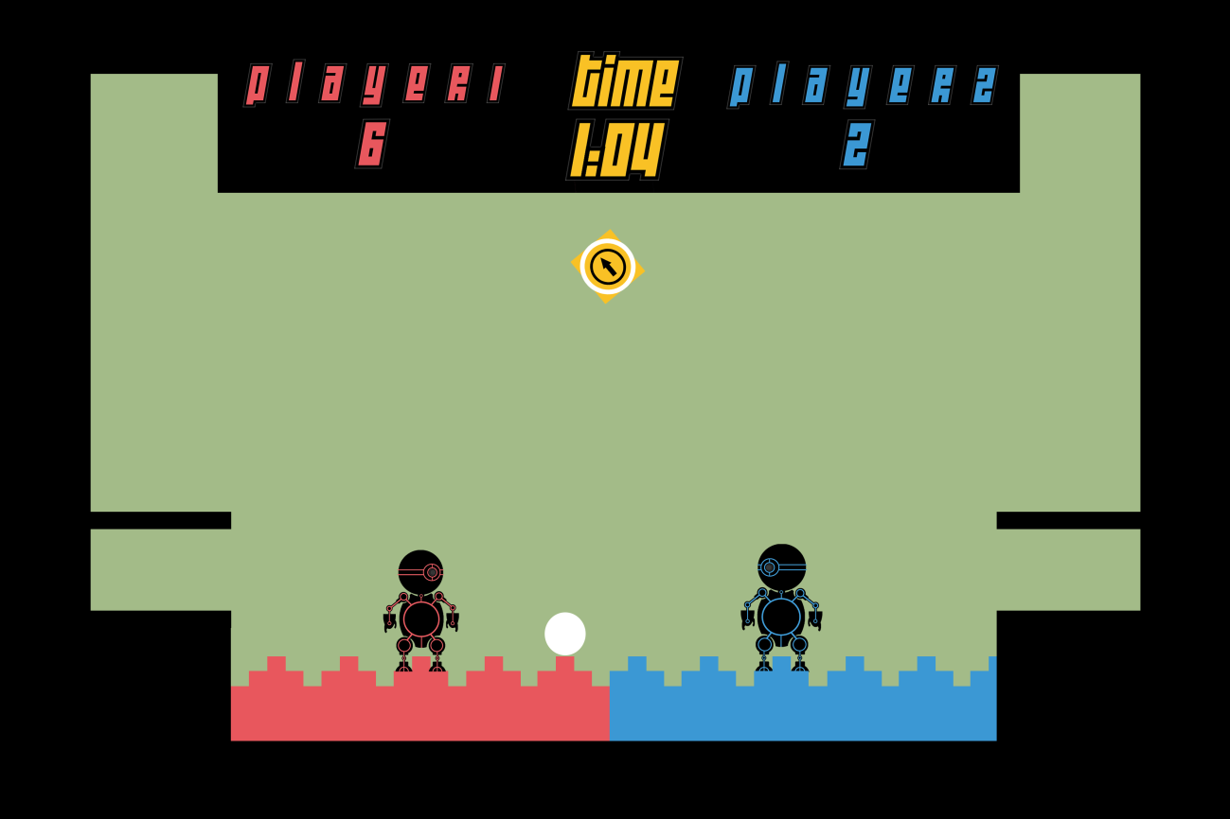
Where We Finished Last Time…
Chose the game concept that takes advantage of a wave to create physics gameplay.

Slide 3
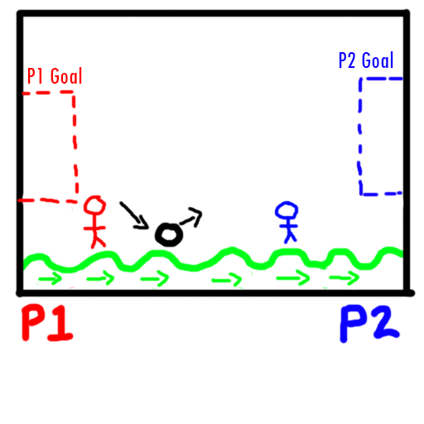
Mechanics Part 1
Two players must get a single ball into the opponents goal.
The physics comes from the bounciness of the ball, offset with the ground which is mimicking a waves behaviour.

Slide 4
Mechanics Part 2
The main mechanic is the wave generation, how fast it moves and how high its peaks are (or low its troughs are).
Aimed towards evoking hard and easy fun. There will be challenge, but carefully tuned as to allow for a more casual and easy-going competitive experience.
Laughter and friendly competition are the desired experiences for this concept.

Slide 5
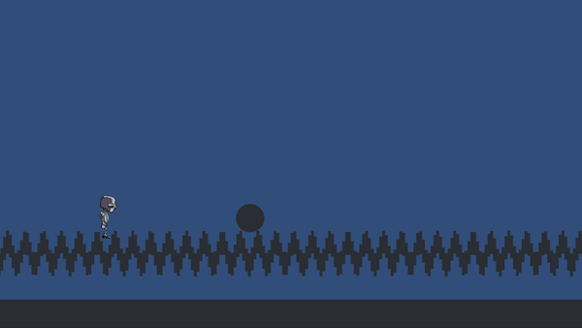
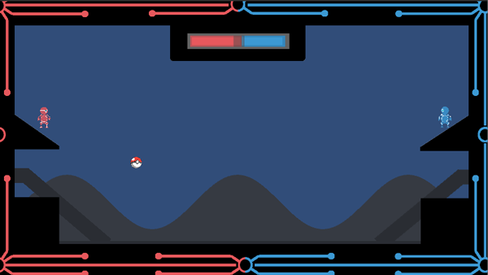
The Iterations (So Far…)
Used cubes to generate the wave. Discarded quickly due to problems with collisions detection.
Uses fancy mathematics to generate a wave from a single object.

Slide 6
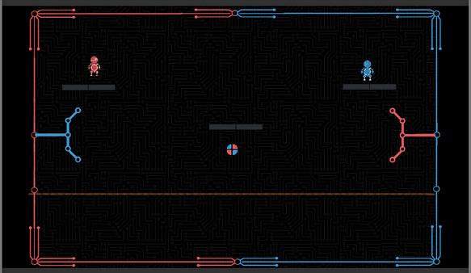
The Iterations (So Far…)
Using hinge joints to create the wave. Would have been a much less time consuming to implement/iterate.
Difficulty creating an actual wave using this method.

Slide 7
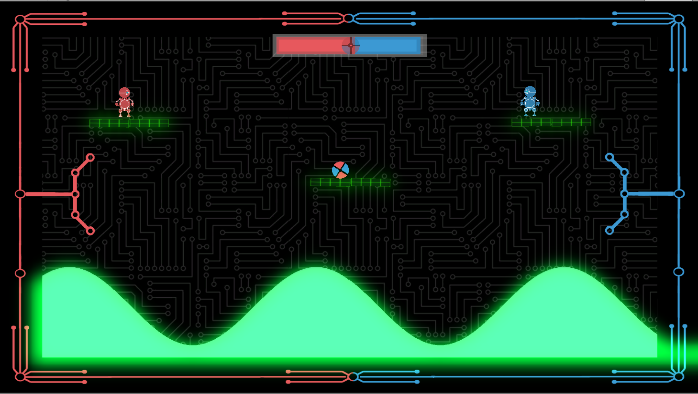
Where Are We Now?

Slide 8
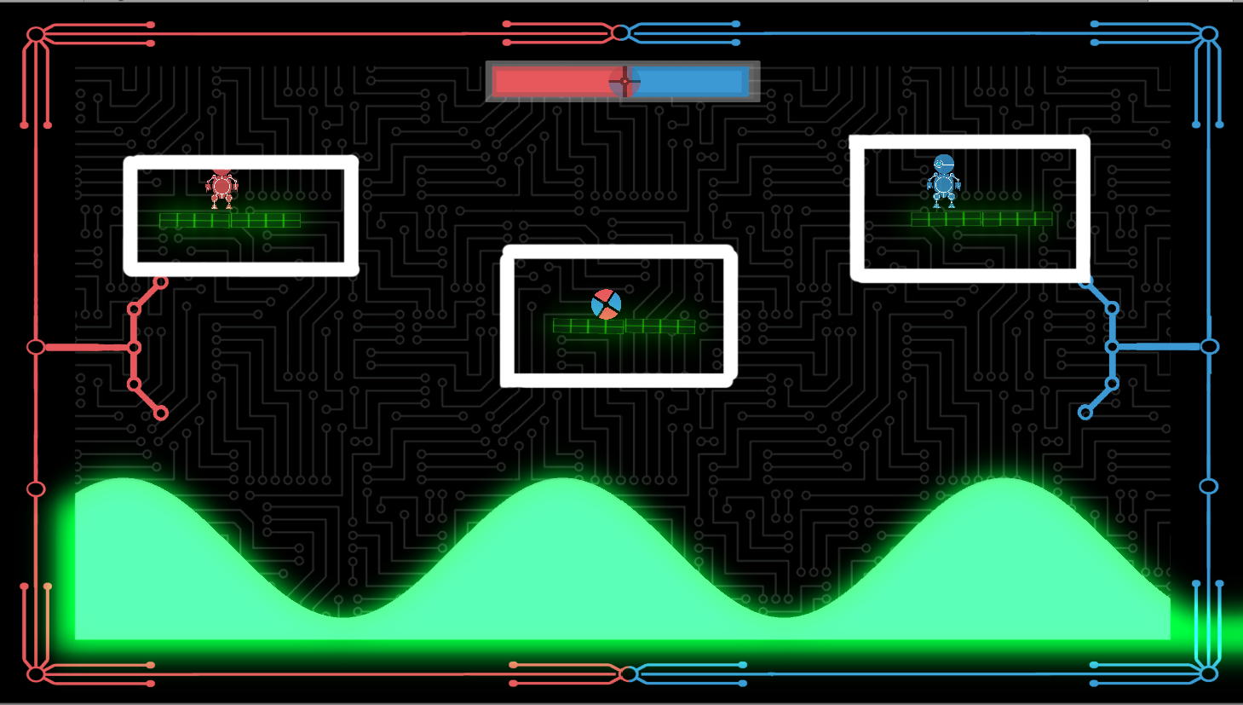
Balancing Skill vs Chance
The skill is in the precision of judging the most opportune moment to hit the ball directly or when to bounce it off the wave.
The chance comes from how the wave alters the angle in which the ball bounces.
The platforms provide both chance and skill opportunities.

Slide 9
Playtesting
Playtesting results…
8 people play tested in total.

Slide 10
Playtesting
Play tested both types of wave, and decided to use the mathematically generated wave as it created a better experience and allowed for a more customisable wave.

Slide 11
Playtesting
Observations
Players were laughing, mocking each other and competing against each other in a friendly way.
There weren’t any players winning/scoring more consistently than the other.
No players gave up before the game was over.
If a player is more experienced at the game, then skill can overcome chance. This may need to be balanced in future.
The player controllers need to be fine tuned.

Slide 12
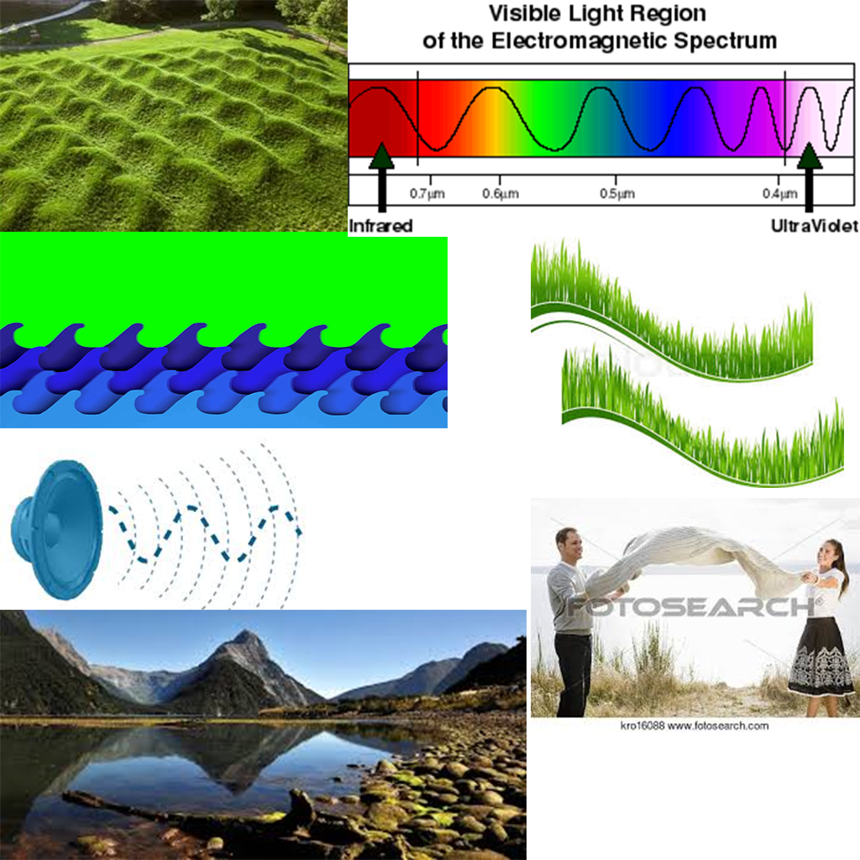
Aesthetics
Minimalistic design to keep the visual hierarchy uncluttered, for faster asset creation, and to stay within the abilities of the developers.
First step was to visualise the wave, whilst allowing for technological restrictions. (texture stretching, sprites vs materials).
Due to uncertainties about how the wave would be generated, this task was deprioritised.

Slide 13
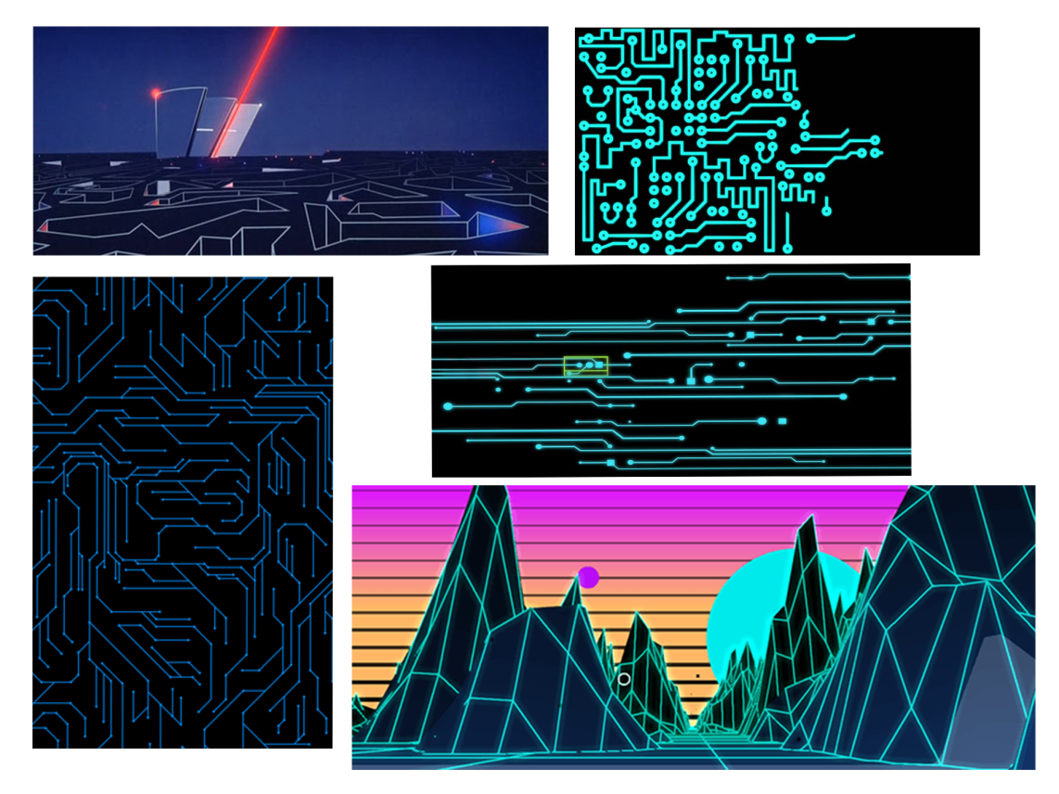
Concept Art (Vector)
Vector Graphics/Outline Style. Easy to create, easy to balance colour harmonies and to draw attention where it is required.

Slide 14
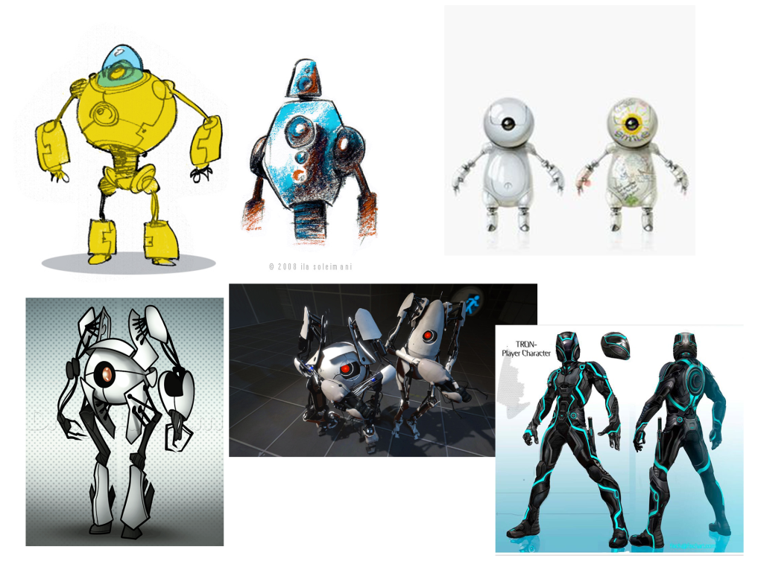
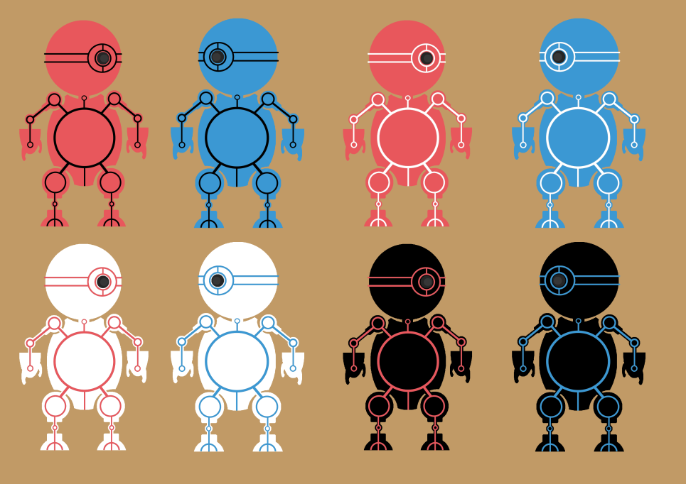
Concept Art (Vector)
Characters using rounded design to promote friendly and harmless impressions, and to steer away from intense competition between players.
Created in a variety of colours to easily compare colour harmonies.

Slide 15
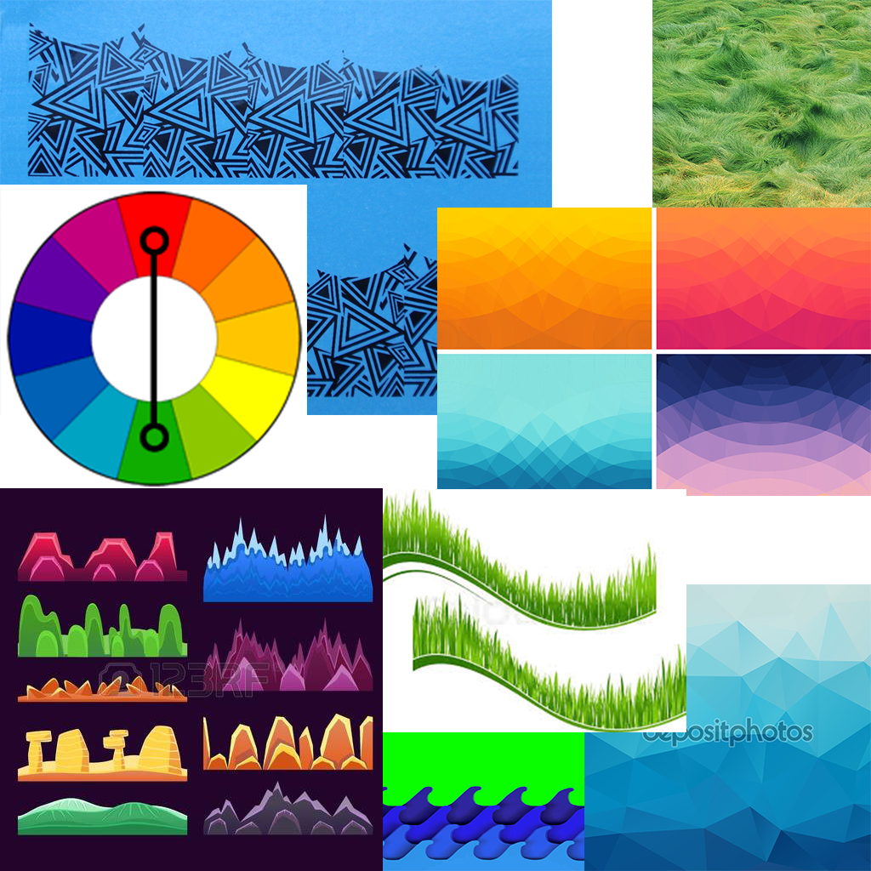
Concept Art (Geometric)
Geometric styled assets could be beneficial as they often use negative space to provide detail.
The challenge would be in keeping the visual hierarchy uncluttered.

Slide 16
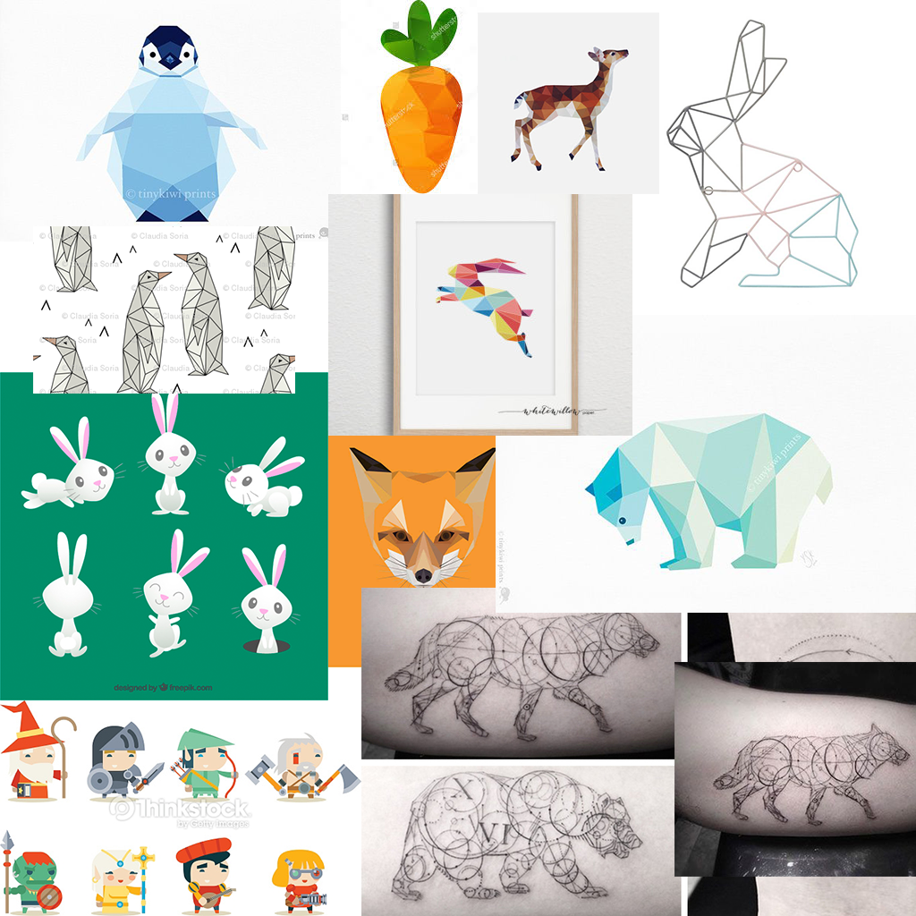
Concept Art (Geometric)
Geometric styled characters, but still rounded for the friendly impression.
Can offer more diversity in character designs and colour harmony's.
More time consuming to create, can be challenging to create to a high standard.

Slide 17
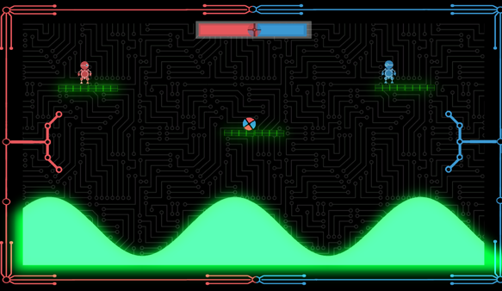
Current Iteration

Slide 18
Where Do We Go From Here?
Fine tune the player controllers.
Balance the skill/chance mechanics.
Iterate colour harmonies.
Wave variations.
Playtest these changes.

Slide 19
Sprint Information
Hours Logged
Connor: 36
Henry: 34
Sam: 0
Heather: 35
Emails Sent
Connor: 48
Henry:21
Sam:2
Heather: 35

Slide 20
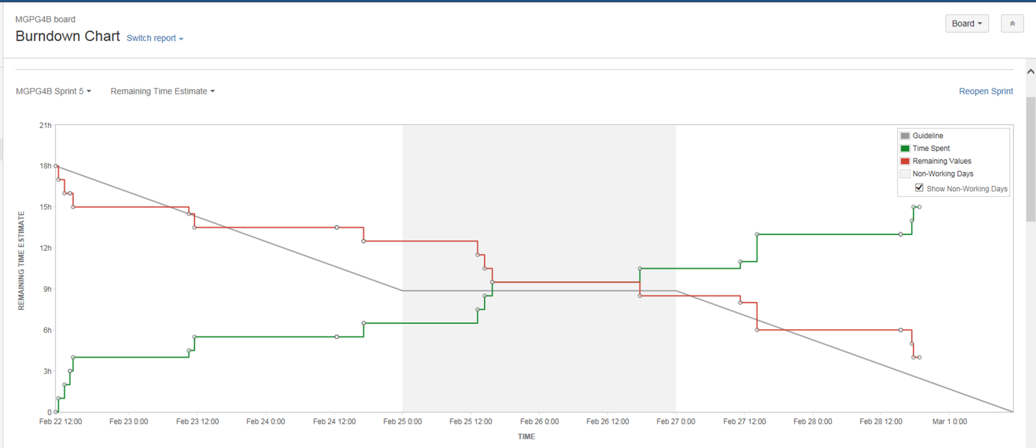
Burndown Chart

Slide 21
Questions?

